Slide 1

Object Tracking
1
Presented by
Ahmed Omar Code: 180007
Ibrahim Hassan Code: 180165
Khalid Zaghloul Code: 180052
Mustafa Sayed Code : 180132
Abdullah Mamdouh Code : 180085
Supervised by
Dr. Ahmed Elngar
Faculty of Computers and Artificial Intelligence
Beni-Suef University
Computer Vision: Object Tracking

Slide 2
Outline
Definitions & Applications
Types of Object Tracking
Levels of Object Tracking
Object Tracking challenges
Object Tracking Algorithms
Conclusion

Slide 3
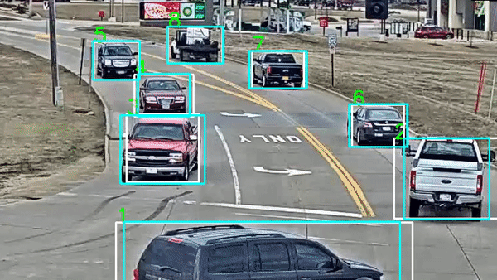
Definitions
Object tracking is an application of deep learning where the program takes an initial set of object detections and develops a unique identification for each of the initial detections and then tracks the detected objects as they move around frames in a video.
In other words, object tracking is the task of automatically identifying objects in a video and interpreting them as a set of trajectories with high accuracy.
Often, there’s an indication around the object being tracked, for example, a surrounding square that follows the object, showing the user where the object is on the screen.

Slide 4
Object Tracing Applications
Applications of object Tracing
Self Driving Cars
Ball Tracking in Sports
surveillance and security
traffic monitoring
video communication
robot vision
animation

Slide 5
Types of Object Tracking

Slide 6
Video Tracking
Video tracking is an application of object tracking where moving objects are located within video information. Hence, video tracking systems are able to process live, real-time footage and also recorded video files.
The processes used to execute video tracking tasks differ based on which type of video input is targeted
Different video tracking applications play an important role in video analytics, in scene understanding for security, military, transportation, and other industries. Today, a wide range of real-time computer vision and deep learning applications use video tracking methods

Slide 7
Image Tracking
Image tracking is meant for detecting two-dimensional images of interest in a given input. That image is then continuously tracked as they move in the setting.
Image tracking is ideal for datasets with highly contrasting images (ex. black and white), asymmetry, few patterns, and multiple identifiable differences between the image of interest and other images in the image set.
Image tracking relies on computer vision to detect and augment images after image targets are predetermined.

Slide 8
Object tracking camera
Modern object tracking methods can be applied to real-time video streams of basically any camera. Therefore, the video feed of a USB camera or an IP camera can be used to perform object tracking, by feeding the individual frames to a tracking algorithm. Frame skipping or parallelized processing are common methods to improve object tracking performance with real-time video feeds of one or multiple cameras.

Slide 9
Visual Tracking
Visual tracking or visual target-tracking is a research topic in computer vision that is applied in a large range of everyday scenarios. The goal of visual tracking is to estimate the future position of a visual target that was initialized without the availability of the rest of the video.

Slide 10
Levels of Object Tracking

Slide 11
Levels of Object Tracking
Object Tracking consists of multiple subtypes because it is such a broad application. Levels of object tracking differ depending on the number of objects being tracked.
Multiple Object Tracking (MOT)
Single Object Tracking

Slide 12
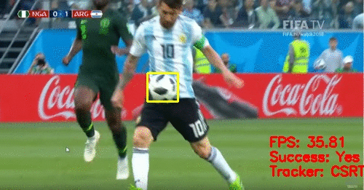
Single Object Tracking
Single Object Tracking (SOT) creates bounding boxes that are given to the tracker based on the first frame of the input image.
SOT implies that one singular object is tracked, even in
environments involving other objects. Single Object Trackers
are meant to focus on one given object rather than multiple
The object of interest is determined in the first frame, which
is where the object to be tracked is initialized for the first time. The tracker is then tasked with locating that unique target in all other given frames.
SOT falls under the detection-free tracking category, which means that it requires manual kkinitialization of a fixed number of objects in the first frame

Slide 13
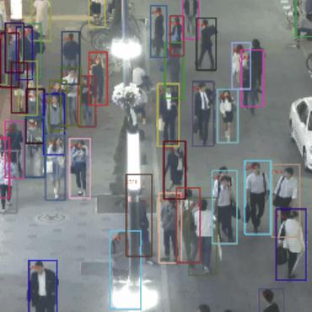
Multiple Object Tracking (MOT)
Multiple object tracking is generally divided between locating multiple objects, maintaining their identities and generating their individual trajectories with high accuracy.
multi-object tracking aims to track more than one object in digital images. It is also called multi-target tracking, as it attempts to analyze videos to identify objects (“targets”) that belong to more than one predetermined class
Multiple object tracking is of great importance in autonomous driving, where it is used to detect and predict the behavior of pedestrians or other vehicles. Hence, the algorithms are often benchmarked on the KITTI tracking test. KITTI is a challenging real-world computer vision benchmark and image dataset, popularly used in autonomous driving.

Slide 14
Multiple Object Tracking (Cont.)
MOT requires two additional tasks to be solved:
determining the number of objects
(2) maintaining their identities.
Apart from the common challenges shared by SOT and MOT, further key issues that complicate MOT include among others:
frequent occlusion
initialization and termination of tracks
similar appearance of objects
Interactions amongst multiple objects

Slide 15
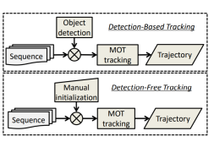
Multiple Object Tracking (Cont.)
Most MOT frameworks can be grouped into two sets:
(1) Detection-based Tracking (DBT)
(2) Detection-free Tracking (DFT)
DBT: Objects are first detected and then linked into trajectories.
Two key issues for DBT framework: object detector must be trained in advance (offline); performance of tracking algorithm is highly dependent upon effectiveness of detector (e.g. RCNN, YOLO).
DFT: Requires manual initialization of fixed number of objects in first frame, then localizes objects in subsequent frames.
DBT is more popular because new objects discovered and disappearing objects are terminated automatically. DFT can’t accommodate cases for which objects appear – but it is nevertheless free of pre-trained detectors (no deep learning needed

Slide 16
Multiple Object Tracking (Cont.)
Processing Modes for MOT:
online tracking
offline tracking
Online, tracking methods only rely on the past information available up to the current frame, while offline approaches employ observations from both past and future.
For real-time tracking we require online tracking

Slide 17
Multiple Object Tracking (Cont.)
Multiple object tracking algorithm
Appearance Model
Inference Model
Motion Model
Interaction Model
Exclusion Model
Occlusion Handling
Components of an MOT Algorithm

Slide 18
Components of MOT Algorithm
Appearance Model
Appearance is an important cue for affinity computation in MOT. However, it is usually not considered the core component of a MOT algorithm.
Appearance models consist of
visual representation that describes an object according to different kinds of features (e.g. local features or region features such as optical flow, HOG features, region covariance)
statistical measuring (using single cues, e.g., distance between color histograms or multiple cues involving a fusion of information, e.g. boosting, cascading, etc.)

Slide 19
Components of MOT Algorithm(Cont.)
2. Motion Model
The motion model captures the dynamic behavior of an object. In most cases objects are assumed to move smoothly and thereby maintain object continuity conditions
Linear Motion Model: the most popular motion model for MOT, assumes constant velocity of objects; one can further impose velocity/position/acceleration smoothness constrains.
Non-linear motion model: more complex model (often) can yield better results when linking tracklets of objects

Slide 20
Components of MOT Algorithm(Cont.)
3. Interaction Model
Interaction model, also known as mutual motion model, Captures influence of an object on other objects. Example: object experiences “force” from other objects, i.e. customer adjusts speed/trajectory to avoid others. these are examples of two typical interaction models known as the social force models and the crowd motion pattern models .
Social forces model: In these models, each object is considered to be dependent on other objects and environmental factors, In social force models, targets are considered as agents which determine their velocity, acceleration, and destination based on observations of other objects and the environment. More specifically, in social force models, target behavior is modeled based on two aspects, individual force and group force.

Slide 21
Interaction Model Cont..
Individual force: use continuity and fidelity constraints
group force: use
attraction (individuals moving together stay together)
repulsion (groups maintain some distance from one another)
coherence (group elements move with commensurate velocity, etc.)

Slide 22
Components of MOT Algorithm(Cont.)
4. Exclusion Model
Constraint set employed to avoid physical collisions for MOT problem; intuition: two objects can’t occupy the same physical space. Two types:
detection-level exclusion (can’t assign detection to same space in same frame for two distinct customers)
(2) trajectory-level exclusion (trajectories must maintain some minimal epsilon difference).
For in-store environment, exclusion model could incorporate intrinsic exclusions based on surrounding environment.
To model exclusion: (1) can use exclusion graph to capture constrain, (2) optimize inference to encourage connected nodes to have different labels, (3) further distinction between soft/hard modeling.

Slide 23
Components of MOT Algorithm(Cont.)
5. Occlusion Model
Occlusion is perhaps the most critical challenge in MOT. It is a primary cause for ID switches or fragmentation of trajectories. In order to handle occlusion, various kinds of strategies have been proposed.
Part-to-whole : the popular way is dividing a holistic object (like a bounding box) into several parts and computing affinity based on individual parts.
Buffer-and-recover : buffer observations when occlusion occurs, when occlusion ends, object states are recovered based on the buffered observations and the stored states before occlusion.
Hypothesize-and-test : This strategy sidesteps challenges from occlusion by hypothesizing proposals and testing the proposals according to observations at hand. As the name indicates, this strategy is composed of two steps, hypothesize and test.

Slide 24
Components of MOT Algorithm(Cont.)
6. Inference Model
Probabilistic inference: Usually relies on a Markov assumption:
(i) current object state only depends on previous state
(ii) observation of an object is only relation to its state corresponding to this observation (observations are conditionally independent). States of objects can be estimated by iteratively conducting the prediction and updating steps.
One solution: Kalman fitter (could use Gaussian Process): makes linear system assumption and Gaussian-distributed object states assumption; under these conditions, Kalman filter is optimal estimator.

Slide 25
Inference Model Cont..
Can also model MOT problem as graph bipartite matching problem; two sets of nodes: observations/detections; weights between nodes are affinity measure; can solve greedily or use Hungarian algorithm (classic paradigm for matching with preference problem: “stable marriage problem”; can alternatively use min-cut/max flow network (use for trajectories); graphical models/conditional random fields.

Slide 26
Object Tracking challenges?

Slide 27
Training and Tracking Speed
Algorithms for tracking objects are supposed to not only accurately perform detections and localize objects of interest but also do so in the least amount of time possible. Enhancing tracking speed is especially imperative for real-time object tracking models.
To manage the time taken for a model to perform, the algorithm used to create the object tracking model needs to be either customized or chosen carefully. Fast R-CNN and Faster R-CNN can be used to increase the speed of the most common R-CNN approach.
CNNs (Convolutional Neural Networks) are commonly used for object detection, CNN modifications can be the differentiating factor between a faster object tracking model and a slower one.

Slide 28
Background Distractions
The backgrounds of the input images or the images used to train the object tracking models also affect the accuracy of the model. Busy backgrounds of things that are meant to be tracked can make it difficult to detect small things.
With a blurry or single color background, it is easier for an AI system to detect and track objects. Backgrounds that are too busy, have the same color as the object, or that are too cluttered can make it hard to track results for a small object or a lightly colored object.

Slide 29
Multiple Spatial Scales
Objects meant to be tracked can come in a variety of sizes and aspect ratios. These ratios can confuse the object tracking algorithms into believing objects are scaled larger or smaller than their actual size.
To combat the issue of varying spatial scales, programmers can implement techniques such as:
feature maps
anchor boxes
image pyramids and feature pyramids.

Slide 30
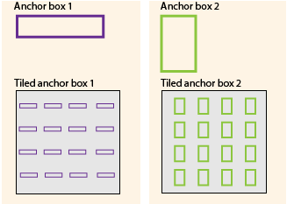
Multiple Spatial Scales techniques
Anchor Box
Anchor boxes are a set of predefined bounding boxes of a certain height and width. These boxes are defined to capture the scale and aspect ratio of specific object classes you want to detect and are typically They are chosen based on the average object size of the objects in a given dataset. Anchor boxes allow various types of objects to be detected without having the bounding box coordinates alternated during localization.

Slide 31
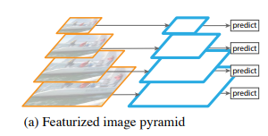
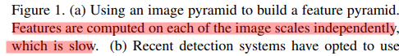
Multiple Spatial Scales techniques
2. feature pyramid
Goal: Feature integration (combining strong-semantics and weak-semantics)
FPN is a general purpose architecture: take a single-scale image as input, generating proportionally sized feature maps at multiple-levels in fully convolutional fashion.
FPN is independent to the backbone
Region Proposal Network
Object detector
Instance Segmentation
FPN is constructed with
Bottom-up pathway
Top-down pathway
Lateral connections

Slide 32

Multiple Spatial Scales techniques
Problem of featured image pyramid
Computation
Memory
Inference time increase considerably
Training deep networks end-to-end on an image pyramid is infeasible because they are memory intensive

Slide 33
Occlusion
In AI vision tasks using deep learning, occlusion happens when multiple objects come too close together (merge). This causes issues for object tracking systems because the occluded objects are seen as one or simply track the object incorrectly. The system can get confused and identify the initially tracked object as a new object
Occlusion sensitivity is a simple technique prevents this misidentification by allowing the user to understand which parts of an image are the most important for the object tracking system to classify. Occlusion sensitivity refers to a measure of the network’s sensitivity to occlusion in different data regions. It is done using small subsets of the original dataset.
Use occlusion sensitivity to gain a high-level understanding of what image features a network uses to make a particular classification, and to provide insight into the reasons why a network can misclassify an image.

Slide 34
Object Tracking Algorithms

Slide 35
Object Tracking Algorithms
Most multiple object tracking algorithms incorporate an approach called tracking-by-detection. The tracking-by-detection method involves an independent detector that is applied to all image frames to obtain likely detections, and then a tracker, which is run on the set of detections
Convolutional Neural Networks (CNN) remain the most used and reliable network for object tracking. However, multiple architectures and algorithms are being explored as well. Among these algorithms are Recurrent Neural Networks (RNNs), Autoencoders (AEs), Generative Adversarial Networks (GANs), Siamese Neural Networks (SNNs), and custom neural networks.

Slide 36
Object Tracking Algorithms(Cont.)
OpenCV Object Tracking
2. DeepSORT
4. SORT (Simple Online and Realtime Tracking)
3. Object Tracking MATLAB

Slide 37
Advantages
In object tracing we use image measurements to estimate position of object, but also incorporate position predicted by dynamics. The main intent behind that is to do less work to look for the object and restrict the search.
It is easy to track an object on a straight road or in a simple environment.
Some methods and techniques in object tracking accurately model the target object.
Many object tracking methods have the ability to prevent background clutter by using a well-curated dataset that has a sparse background.

Slide 38
Disadvantages
Sometimes Tracking objects can be complex due to :
1. Noise in images.
2. Complex object shapes.
3. Real-time processing requirements.
4. Complex object motion.
6. Loss of information caused by projection of the 3D world on a 2D image.
7. Scene illumination changes.
8. Non rigid or articulated nature of objects.
9. Partial and full object occlusions.

Slide 39
Applications
There are many possible different applications in Object tracking for example :
Motion-based recognition, that is, human identification based on gait, automatic object detection and counting how many people are in a certain area.
Automated surveillance, that is, monitoring a scene to detect suspicious activities or unlikely events.
Traffic monitoring, that is, real-time gathering of traffic statistics to direct traffic flow.
Vehicle navigation, that is, video-based path planning and obstacle avoidance capabilities.

Slide 40
Conclusions
Object tracking and detection is a subset of computer vision discipline, which aims to determine the whereabouts of an object in a series of video frames .
A qualitative comparison has been done for different tracking techniques. Based on the acquired results, it is clear that occlusion is a persistent issue, and is arguably from amongst the most challenging matters with regards to object tracking.
Moving object detection and tracking becomes attractive and crucial research topic for researchers since The appearance of many methods for the object detection and tracking.
All the methods have their own advantages and disadvantages, and that's why object tracking single method cannot give good accuracy for different kind of videos with different situation like poor resolution, change in weather condition.

Slide 41
Conclusion
Over the past few decades, object tracking has been an active research area in the field of computer vision. For tracking objects, object detection is the first step. Object detection and tracking has various practical applications, such as motion analysis, people and vehicle tracking, crowd analysis, etc. This paper presents a comprehensive review of popular object tracking concepts developed till date and discusses each concept

Slide 42




Thanks and Acknowledgement
Thank you
42
42
Dr. Ahmed A. Elngar (Ph.D) Assistant Professor Faculty of Computers & Artificial Intelligence
Beni-Suef University, Beni Suef City, office box # (62511),, Egypt
Founder and Chair of the Scientific Innovation Research Group (SIRG)
Managing Editor in Journal of CyberSecurity and Information Management (JCIM)
Email: elngar_7@yahoo.co.uk
Email: ahmedelnagar@fcis.bsu.edu.eg Mobile : (+2)01007400752
www.sirg.club

